Slide 1

Grocery Store Management
Batch 533
K. Sanjay Kumar
Batch 536
P. Meghna

Slide 2
About me
K. Sanjay Kumar
Btech(Civil) from Anurag Group of Institutions
Interested in Data Analytics to analyze data, solve real-world problems, and make smart decisions using technology
LinkedIn: https://www.linkedin.com/in/korrawath-sanjay-kumar-711b2b414/
GitHub: https://github.com/sanjaykorrawath96-sys
P. Meghna Reddy
B.Tech (IT) from Sreenidhi Institute of Science and Technology
Interested in Data Analytics because it combines programming, analytics, and business insights to create impactful solutions
LinkedIn: linkedin.com/in/meghna-palwai
GitHub: github.com/palwaimeghna11

Slide 3
Agenda
Business Problem
Problem Statement
Objective
Introduction
Data Description (Data Schema Description, ER Diagram, Cardinalities)
Queries
Conclusion
Recommendation
Q/A
Thank you

Slide 4
Business Problem
Grocery stores often face challenges in managing inventory, customer orders, product sales, suppliers, and employee activities efficiently. Manual tracking of these operations can lead to inaccurate billing, stock shortages, poor sales analysis, and difficulty in monitoring business performance. The lack of a centralized system makes it hard to identify top-selling products, customer purchasing patterns, revenue trends, and employee performance.

Slide 5
Problem Statement
The Grocery Store Management System aims to develop a relational database system that stores and manages data related to customers, products, suppliers, employees, and orders. The project focuses on using SQL queries to analyze sales, customer behavior, product performance, supplier contribution, and operational efficiency to support better business decision-making.

Slide 6
Objective
Design and implement a relational database for grocery store operations
Manage products, suppliers, customers, employees, and orders efficiently
Analyze customer purchasing behavior and sales trends
Identify top-selling products and high-value customers
Evaluate supplier and employee performance
Generate business insights using SQL concepts like joins, aggregations, subqueries, and filtering techniques

Slide 7
Introduction
The Grocery Store Management System is an SQL-based project designed to manage grocery store operations using a relational database. It organizes data related to customers, products, suppliers, employees, categories, and orders across seven interconnected tables. The project analyzes sales revenue, customer purchasing behavior, and product performance using SQL queries. It identifies top-selling products, high-value customers, and the contributions of suppliers and employees. SQL concepts such as joins, aggregate functions, subqueries, and filtering are used to extract meaningful insights. The main goal is to improve operational efficiency and support better business decision-making.

Slide 8
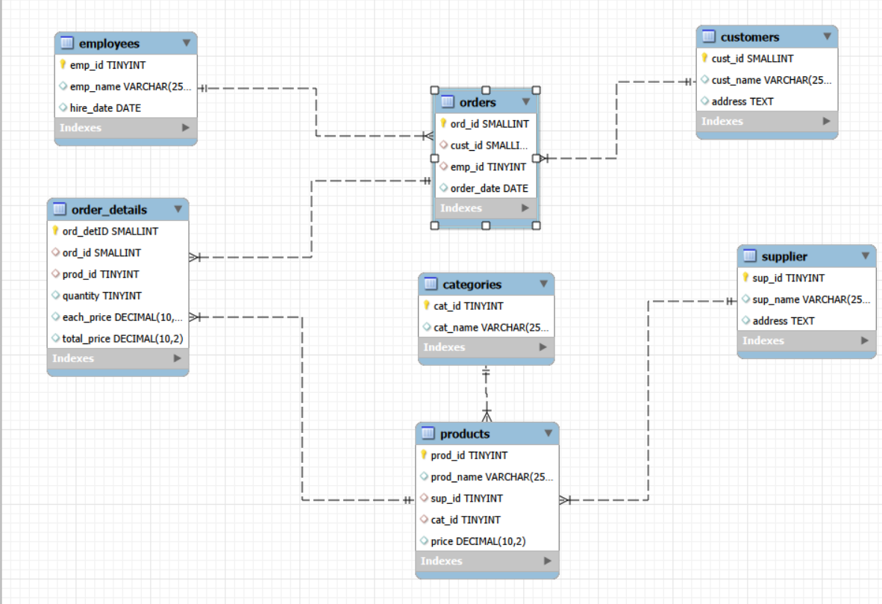
ER Diagram
One-to-Many from Customers to Orders
One-to-Many from Employees to Orders
One-to-Many from Orders to Order Details
One-to-Many from Products to Order Details
One-to-Many from Suppliers to Products
One-to-Many from Categories to Products

Slide 9
Data Schema Description
Supplier: Stores supplier details, including supplier ID, name, and address.
Categories: Contains product category information, such as category ID and category name.
Employees: Stores employee details, including employee ID, name, and hire date.
Customers: Maintains customer information, including customer ID, name, and address.
Products: Stores product details, including product ID, name, price, supplier ID, and category ID.
Orders: Records customer orders, including order ID, customer ID, employee ID, and order date.
Order Details: Contains individual items in each order, including product ID, quantity, unit price, total price.

Slide 10


Queries
How many unique customers placed orders?
Counts the total number of unique customers who have placed orders in the store.

Slide 11
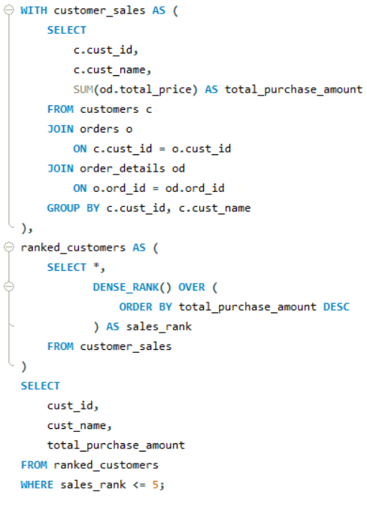
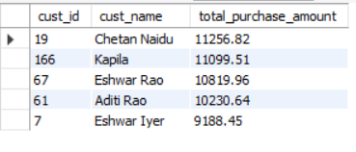
Queries
Top 5 Customers by Spending
Identifies the top 5 customers with the highest total spending in the grocery store.

Slide 12
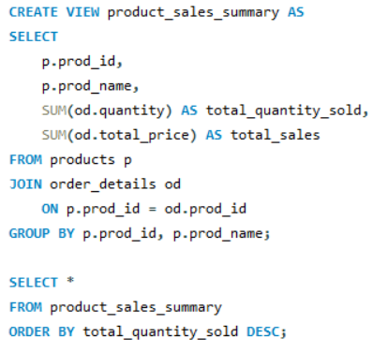
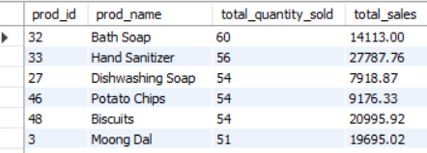
Queries
Products with Highest Sales Quantity
Identifies the products with the highest sales quantity to determine best-selling items.

Slide 13
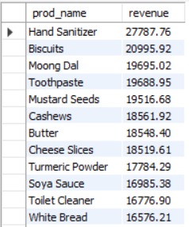
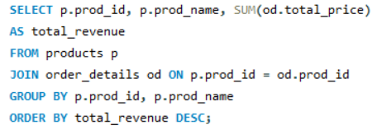
Queries
Revenue Generated by Each Product
Calculates the total revenue generated by each product based on sales transactions.

Slide 14
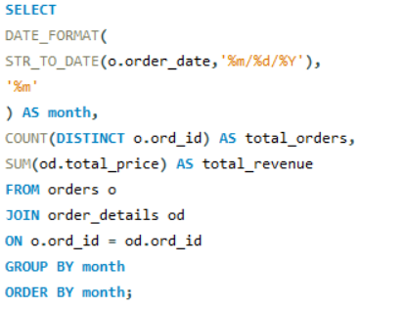
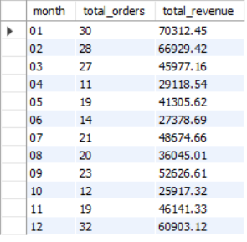
Queries
What are the monthly trends in order volume and revenue?
Order volume and revenue fluctuate across months, with January showing the highest sales performance and October recording the lowest.

Slide 15
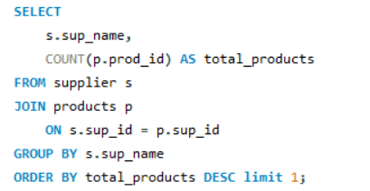

Queries
Which supplier provides the most products?
Supplier contributing the highest number of products to the inventory.

Slide 16
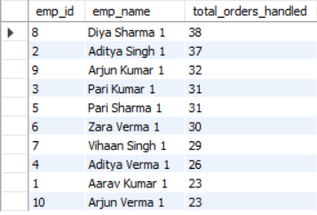
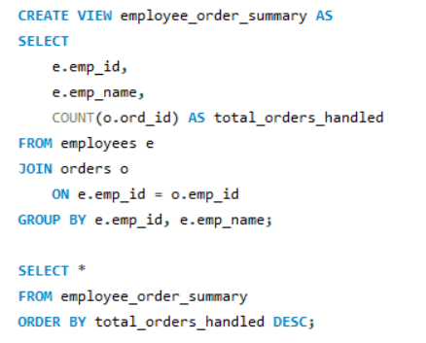
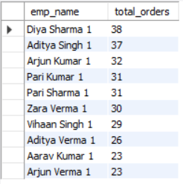
Queries
Employee Handling Most Orders
Identifies the employee who handled the highest number of customer orders.

Slide 17
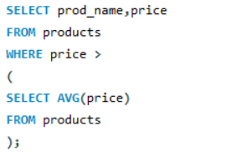
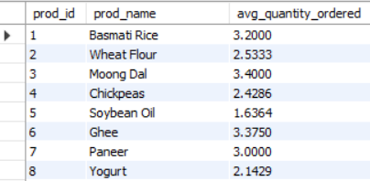
Queries
Average Quantity Ordered per Product
Identifies products priced higher than the average product price in the store.

Slide 18
Recommendations
Focus on retaining high-value customers through loyalty programs.
Maintain higher inventory for top-selling products.
Increase promotions during high-sales periods.
Strengthen partnerships with high-performing suppliers.
Provide incentives for top-performing employees.
Monitor low-performing products and optimize pricing strategies

Slide 19
Conclusion
Top customers contribute a significant portion of total revenue.
Certain products and categories consistently generate higher sales.
Weekday order volume is higher compared to weekends.
Some suppliers contribute more revenue than others.
Employee performance varies based on order handling and sales value.

Slide 20

THANK YOU

